Slide 1
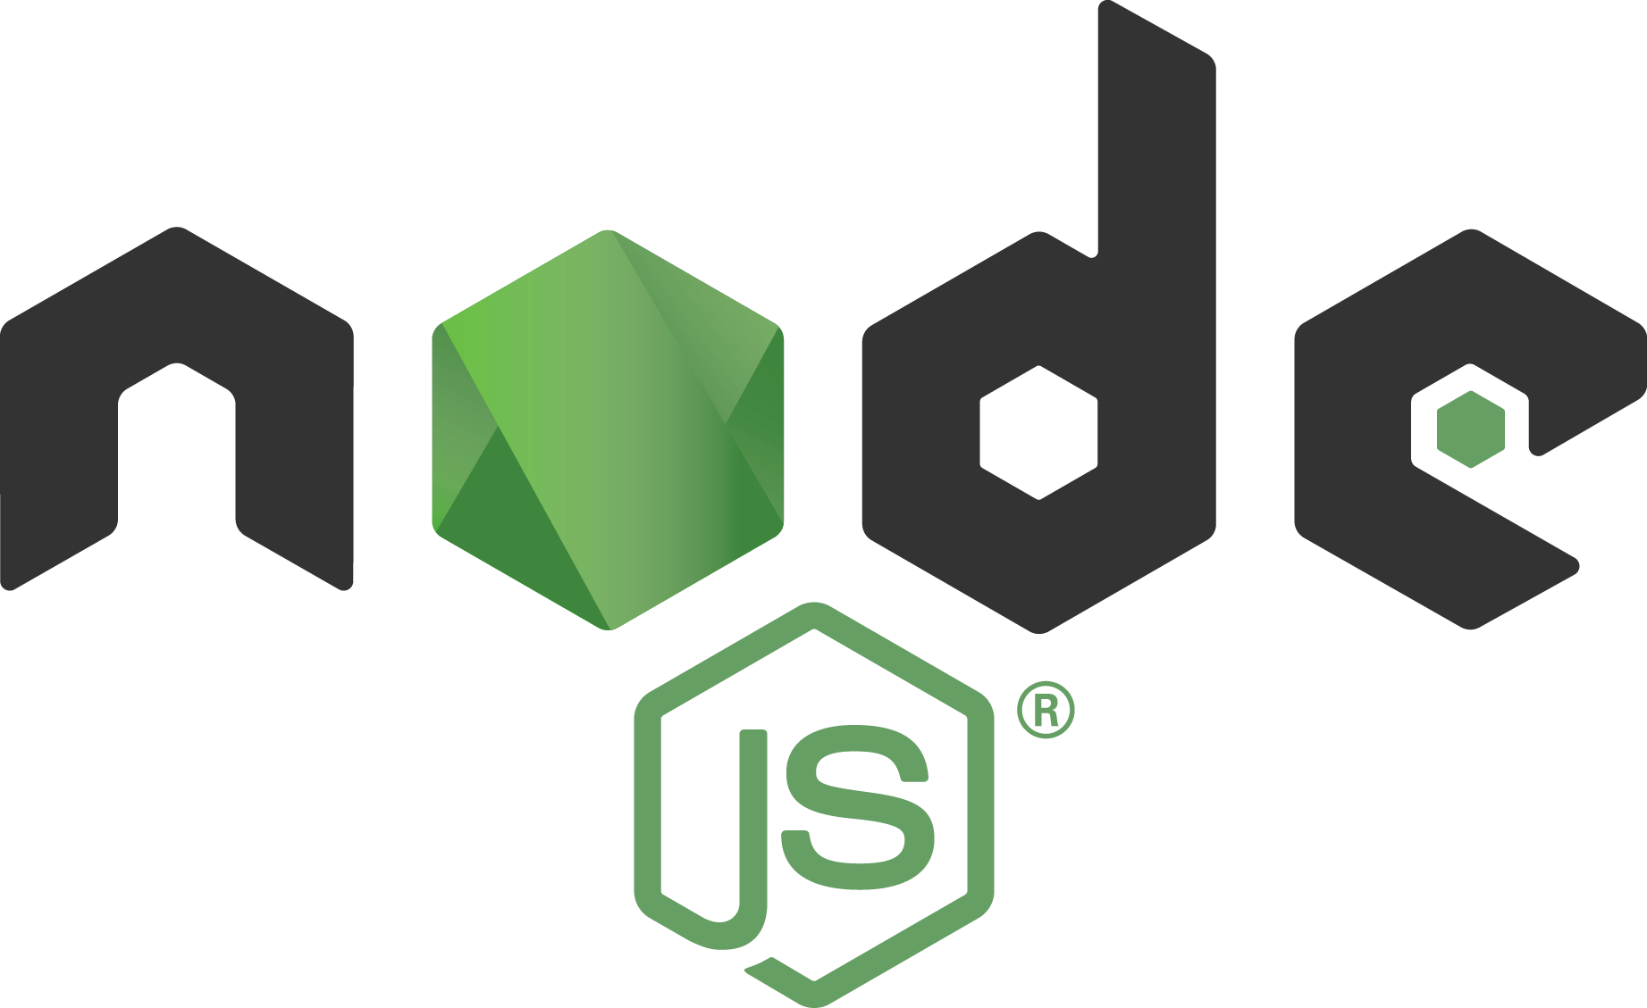
Node js What is it???

Slide 2
Node.js® is a JavaScript runtime built on Chrome's V8 JavaScript engine. Node.js uses an event-driven, non-blocking I/O model that makes it lightweight and efficient. Node.js' package ecosystem, npm, is the largest ecosystem of open source libraries in the world. –www.node.js.org

Slide 3
What is blocking & non-blocking?

Slide 4
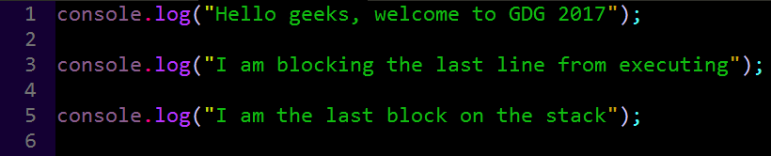
Blocking code

Slide 5
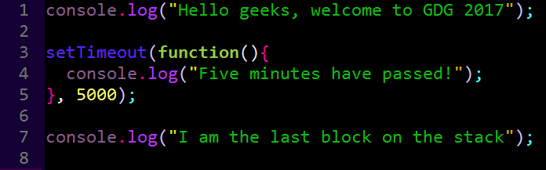
Non blocking code

Slide 6
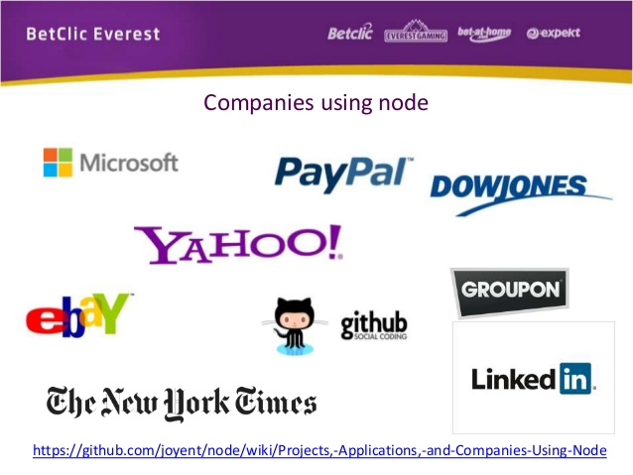
Who uses node?

Slide 7
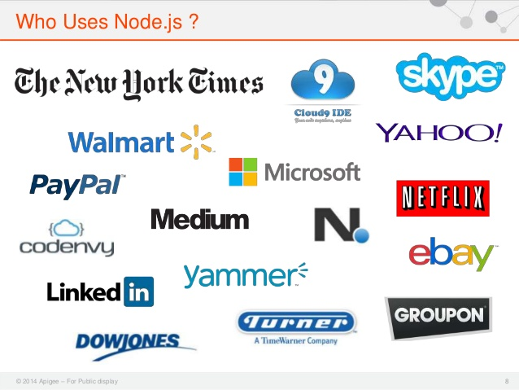
Still more…

Slide 8
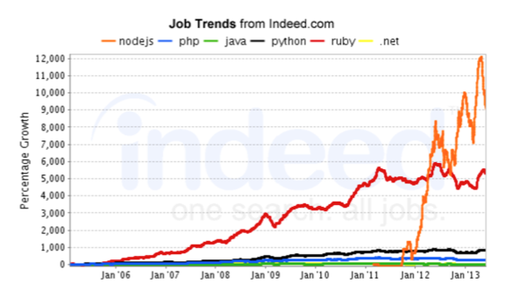
Is it worth learning?

Slide 9
What can I use node js for?

Slide 10
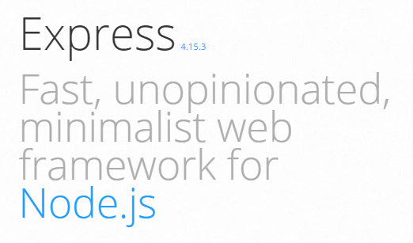
Web applications
https://expressjs.com/

Slide 11
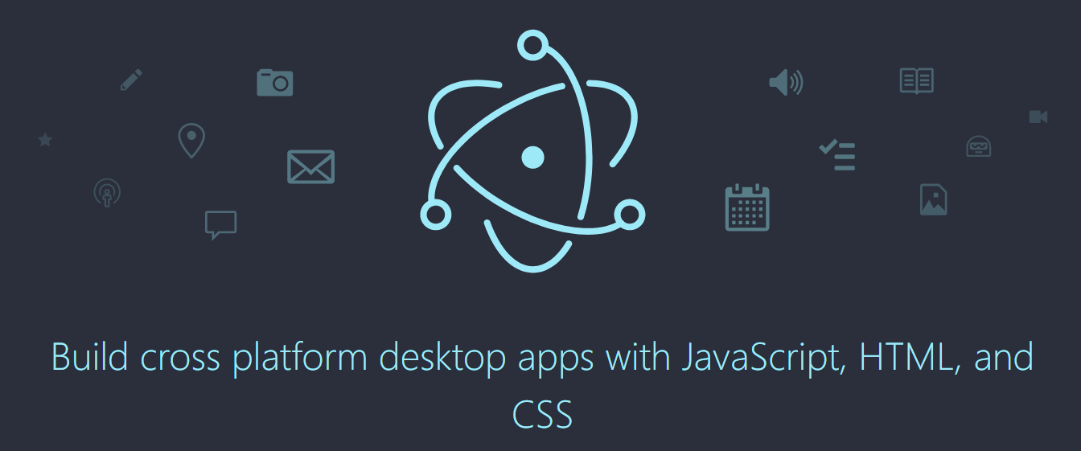
Desktop applications
https://electron.atom.io/

Slide 12
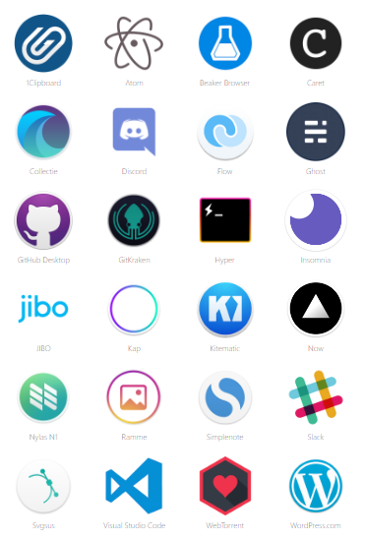
Desktop apps written using Javascript

Slide 13
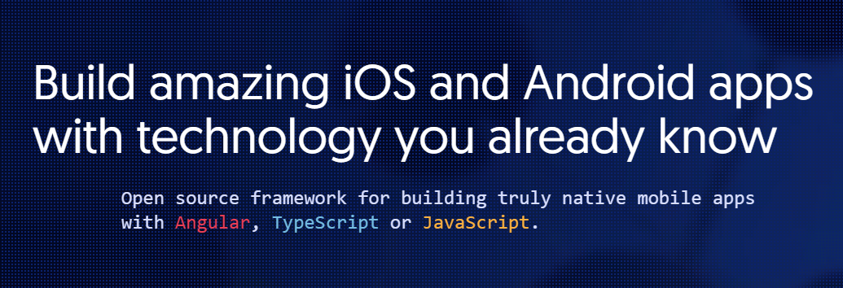
Mobile applications
https://www.nativescript.org/

Slide 14
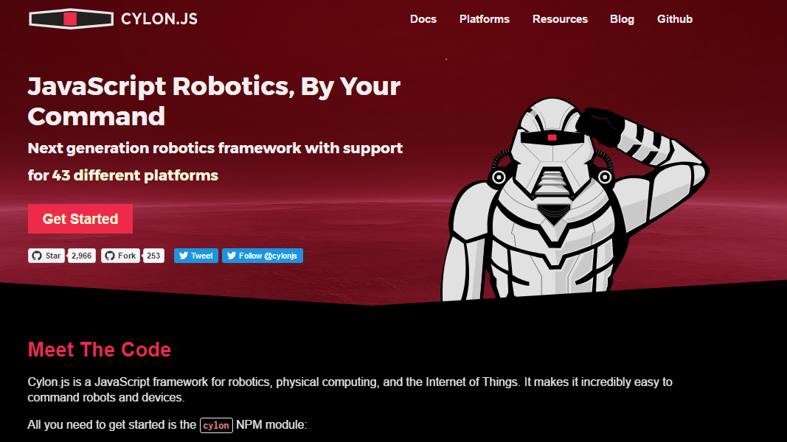
Robotics & IoT
https://cylonjs.com/

Slide 15
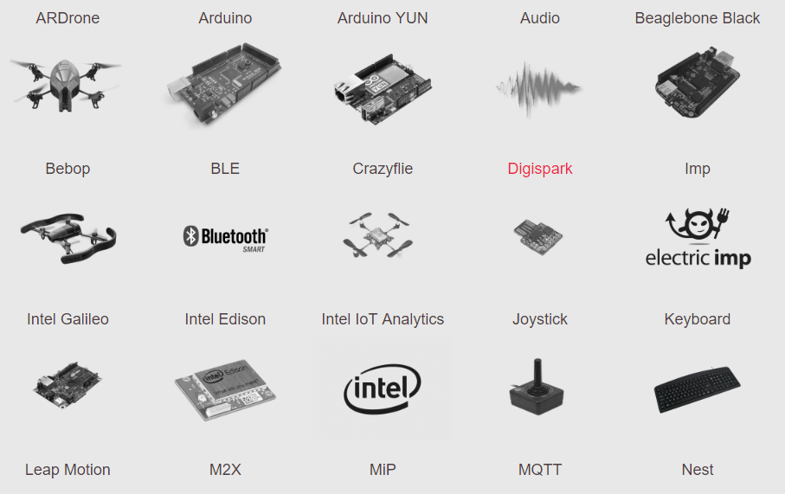
Robotics Platform Support

Slide 16
Have you noticed something?

Slide 17


Slide 18

It is ALL Javascript man!!!
One language rules ‘em all

Slide 19

Really?

Slide 20
How do I get started?
Well, enough of the talk, let’s create our first node js application

Slide 21
Requirements:
Node js Download Node
Suitable text editor (I use sublime text) Download Sublime Text
Web browser (I use Google Chrome) Download Chrome
Terminal or CMD (I use git bash) Download Git Bash

Slide 22
Install the node binaries or msi file and type this on your command line: node -v

Slide 23
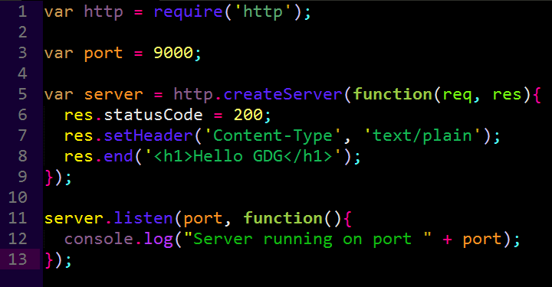
Simple server

Slide 24

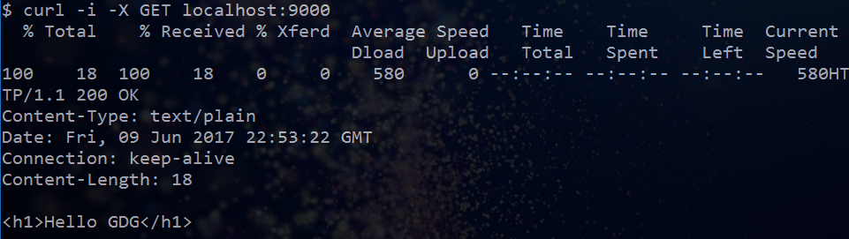
How to run it

Slide 25
Now let’s look at a simple chatting app using node js
Coding section

Slide 26
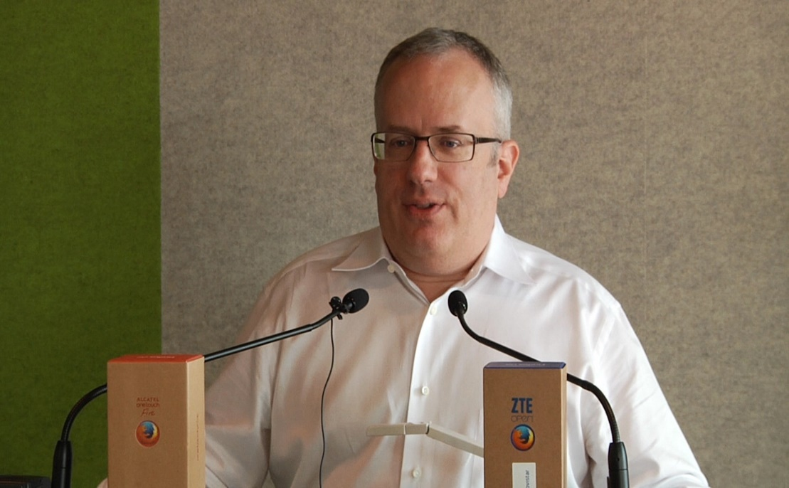

Before then…
Credit to this two guys:
JavaScript Language
Node js

Slide 27
Micro Chat App
Let’s code!!!

